Slide 1
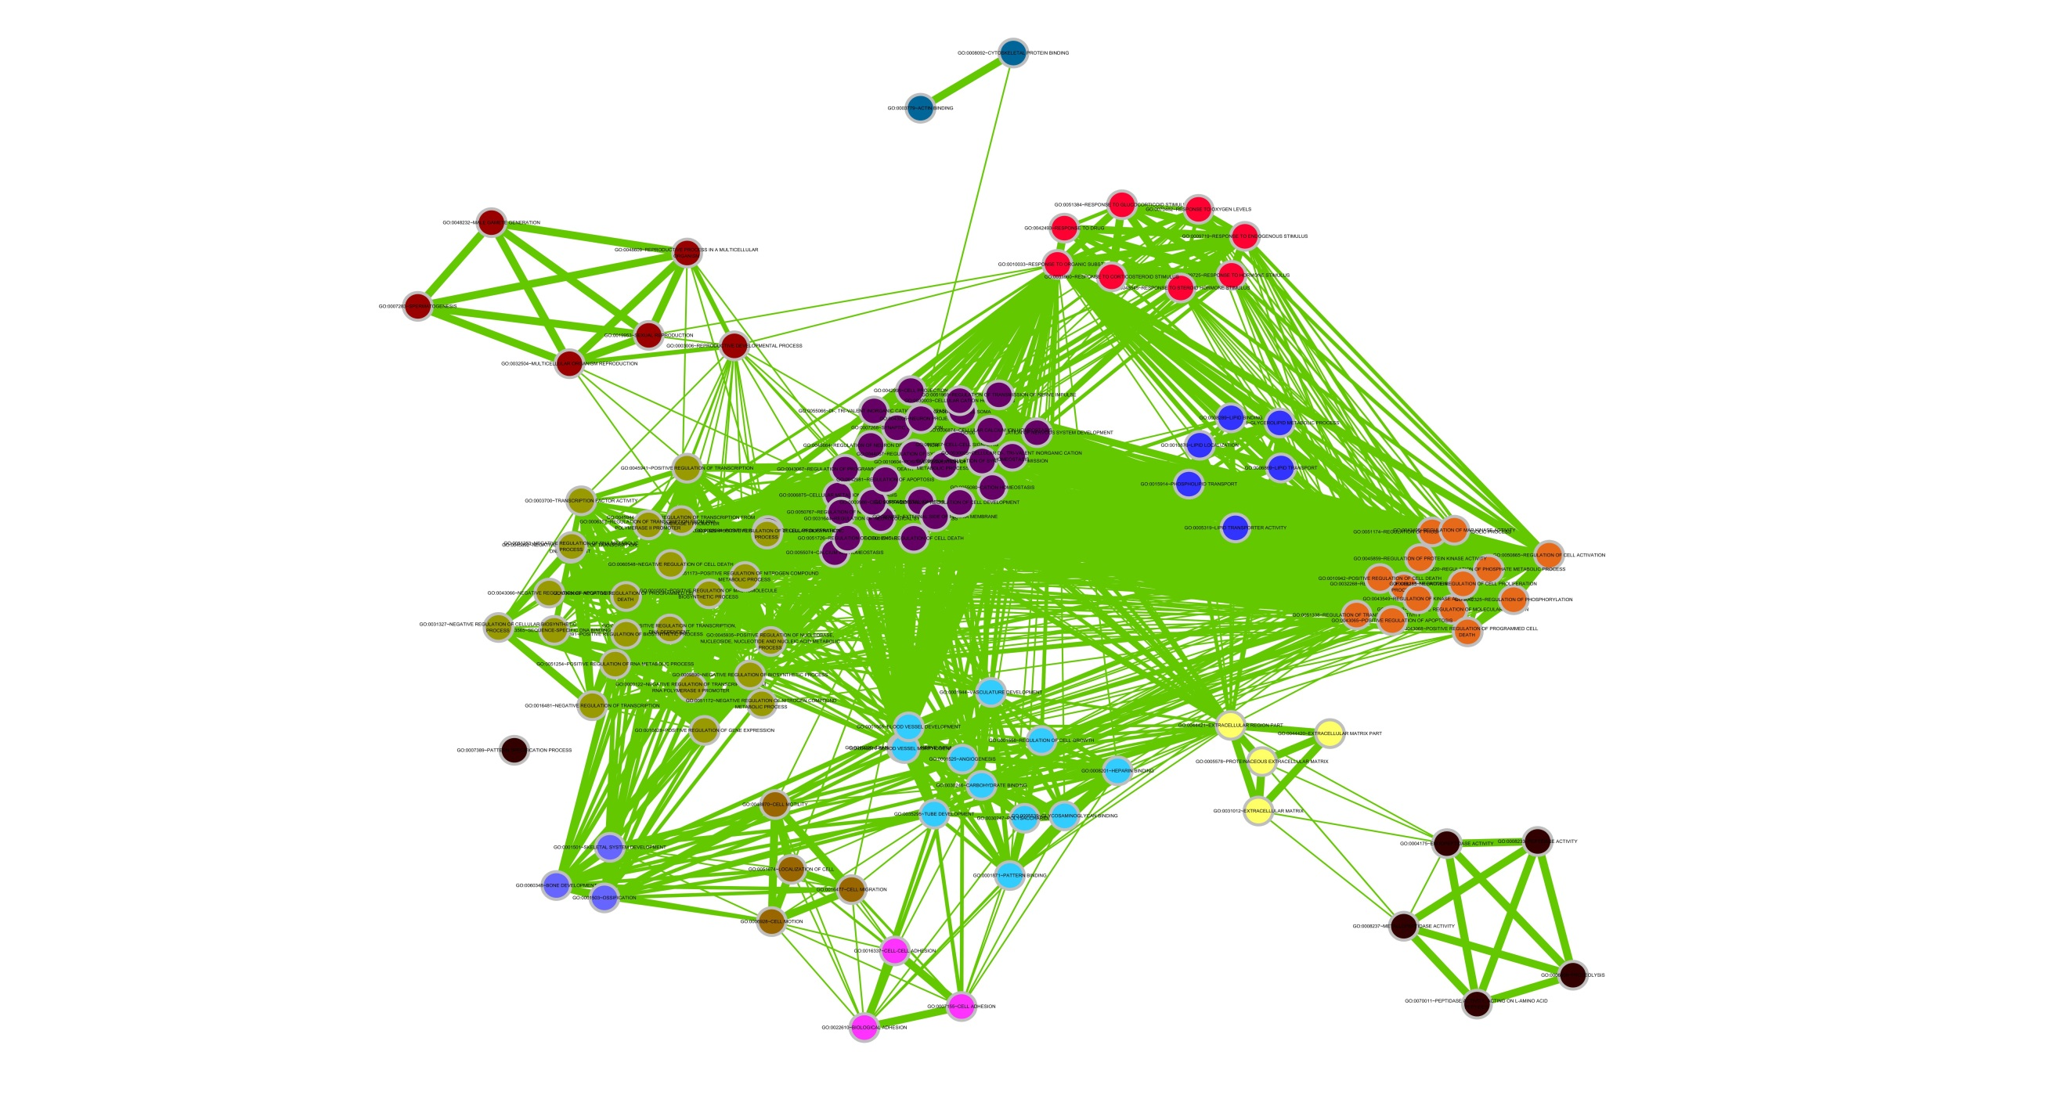
Regulation of cytoskeleton
response to steroid hormone stimulus
Regulation of sexual reproduction
Regulation of lipid
transport/localization
regulation of programmed cell death
positive regulation of transcription,
DNA-dependent/RNA metabolic process
negative regulation
of cell proliferation
regulation of blood
vessel development
Regulation of
extracellular matrix part
Regulation of cell
motility/migration
Regulation of
peptidase activity
Regulation of skeletal
system development
Regulation of cell adhesion

Slide 2
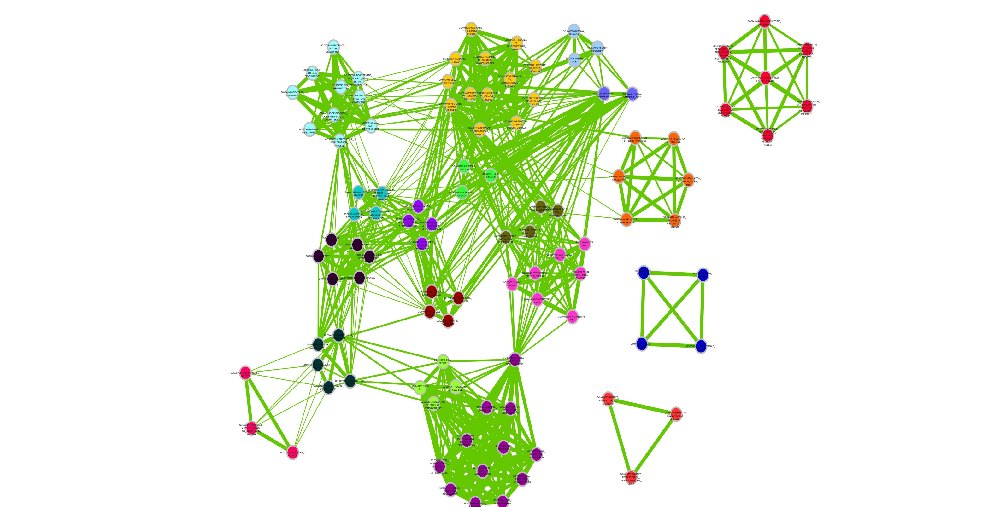
cell_surface_receptor_
linked_signal_transduction
response_to_steroid_hormone_stimulus
regulation_of_transcription,_
DNA-dependent
plasma_membrane_part
Regulation of gonad_development
adherens_junction
regulation_of_blood_vessel_size
reproductive_developmental_process
muscle_cell_differentiation
regulation_of_system_process
cytoplasmic_vesicle_part
Regulation of cytoskeleton
Regulation of cell-cell_signaling
iron_ion_binding
extracellular_matrix
regulation_of_cell_growth
endopeptidase_activity
positive_regulation_of_programmed_cell_death
cell_projection_organization

